Slide 1
Programming fundamentals
Week 02 – Python data types, Boolean logics & Naming convention
Course Instructor :
Engr.Asma Khan

Slide 2
Unary (NOT)and binary operator (AND, OR)
The or operator applied to two Boolean expressions evaluates to False only when both expressions are false. If either one is true or if both are true, then it evaluates to True. >>> 3 < 4 or 4 < 3 True >>> 3 < 2 or 2 < 1 False
The not operator is a unary Boolean operator, which means that it is applied to a single Boolean expression (as opposed to the binary Boolean operators AND and OR). It evaluates to False if the expression is true or to True if the expression is false. >>> not (3 < 4) False

Slide 3
George boole and Boolean algebra (1815 – 1864)
Boolean algebra is the algebra of values true and false. Boolean algebra includes operators and, or, and not, which can be used to create Boolean expressions, expressions that evaluate to true or false. The truth tables below define how these operators evaluate
p | q | p AND q
False | False | False
False | True | False
True | False | False
True | True | True
p | q | p OR q
False | False | False
False | True | True
True | False | True
True | True | True
p | NOT p
False | True
True | False

Slide 4
Assignment operator
As we already know from algebra, it is useful to assign names to values, and we call those names variables. For example, value 3 may be assigned to variable x in an algebra problem as follows: x = 3. The variable x can be thought of as a name that enables us to retrieve value 3 later on. In order to retrieve it, we just need to evaluate x in an expression. The same can be done in Python. A value can be assigned to a variable: >>> x = 4 The statement x = 4 is called an assignment statement. The general format of an assignment statement is:
<variable> = <expression>
An expression we refer to as <expression> lies on the right-hand side of the = operator; it can be an algebraic, Boolean, or other kind of expression. On the left-hand side is a variable referred to as <variable>. The assignment statement assigns to <variable> the value that <expression> evaluates to. In the last example, x is assigned value 4.

Slide 5
Assignment operator (Cont.)
You may remember from algebra that the value of a variable can change. The same is true with Python variables. For example, suppose that the value of variable x is initially 4: >>> x 4 Now let’s assign value 7 to variable x: >>> x = 7 >>> x 7 So the assignment statement x = 7 changed the value of x from 4 to 7.

Slide 6
Assignment and Equality Operators
!
Be careful to distinguish the assignment statement = and the equality operator ==. This is an assignment statement that assigns 7 to variable x: >>> x = 7 The following, however, is a Boolean expression that compares the value of variable x with number 7 and returns True if they are equal: >>> x == 7 True The expression evaluates to True because variable x has value 7.

Slide 7
Variable Names
The characters making up a variable name can be lowercase and uppercase letters from the alphabet (a through z and A through Z), the underscore character (_), and, except for the first character, digits 0 through 9: • myList and _list are OK, but 5list is not. • list6 and l_2 are OK, but list-3 is not. • mylist and myList are different variable names. Even when a variable name is “legal” (i.e., follows the rules), it might not be a “good” name. Here are some generally accepted conventions for designing good names: • A name should be meaningful: Name price is better than name p. • For a multiple-word name, use either the underscore as the delimiter (e.g., temp_var and interest_rate) or camelCase capitalization (e.g., tempVar, TempVar, interestRate or InterestRate); pick one style and use it consistently throughout your program. • Shorter meaningful names are better than longer ones

Slide 8
Reserved words in python and variable names
and | assert | break | class | continue
def | del | elif | else | except
exec | finally | for | from | global
if | import | in | is | lambda
not | or | pass | print | raise
return | try | while
The names below are used as reserved keywords of the Python language.
You cannot use them other than as Python commands.

Slide 9
Strings ‘’ or “”
In addition to number and Boolean types, Python supports a large number of other, more complex, types. The Python string type, denoted str, is used to represent and manipulate text data or, in other words, a sequence of characters, including blanks, punctuation, and various symbols.
A string value is represented as a sequence of characters that is enclosed within quotes: >>> 'Hello, World!' 'Hello, World!' >>> s = 'hello' >>> s 'hello' The first expression, 'Hello, world!', is an expression that contains just one string value and it evaluates to itself, just as expression 3 evaluates to 3. The statement s = 'hello‘ assigns string value 'hello' to variable s.
Note that s evaluates to its string value when used in an expression.

Slide 10
String operators
Python provides operators to process text (i.e., string values). Like numbers, strings can be compared using comparison operators: ==, !=, < , >, and so on. Operator ==, for example, returns True if the strings on either side of the operator have the same value:
>>> s == 'hello' True >>> t = 'world' >>> s != t True >>> s == t False
While == and != test whether or not two strings are equal, the comparison operators < and > compare strings using the dictionary order: >>> s < t True >>> s > t False

Slide 11
Concatenation (joining of two or more strings)
The + operator, when applied to two strings, evaluates to a new string that is the concatenation (i.e., the joining) of the two strings: >>> s + t 'helloworld' >>> s + ' ' + t 'hello world'
In the second example, the names s and t are evaluated to the string values 'hello' and 'world', respectively, which are then concatenated with the single blank space string ' '. If we can add two strings, can we, perhaps, multiply them? >>> 'hello ' * 'world' Traceback (most recent call last): File "<pyshell#146>", line 1, in <module> 'hello ' * 'world' TypeError: cannot multiply sequence by non-int of type 'str'

Slide 12
Math operator * and IN operator
Python programming language and the meaning of the standard operators (+, *, /, etc.) for various types of values (integer, floating point, Boolean, string, etc.) is intuitive. So, intuitively, what do you think should happen when a string gets multiplied by an integer? Let’s try it: >>> 3 * 'A' 'AAA' >>> 'hello ' * 2 'hello hello ' >>> 30 * '-' '------------------------------' Multiplying a string s by an integer k gives us a string obtained by concatenating k copies of string s.
Note how we easily obtained a line (useful for presenting your simple text output, say) by multiplying string '-' 30 times. With the in operator, we can check whether a character appears in a string: >>> s = 'hello' >>> 'h' in s True >>> 'g' in s False

Slide 13
In operator for checking and len()
The in operator also can be used to check whether a string appears in another: >>> 'll' in s True Since 'll' appears in string s, we say that 'll' is a substring of s. The length of a string can be computed using the len() function: >>> len(s) 5
Usage | Explanation
x in s | True if string x is a substring of string s, and false otherwise
x not in s | False if string x is a substring of string s, and true otherwise
s + t | Concatenation of string s and string t
s * n | n * s Concatenation of n copies of s
s[i] | Character of string s at index i
len(s) | Length of string s

Slide 14
Practice Problem 2.1
Write Python algebraic expressions corresponding to the following statements: (a) The sum of the first five positive integers (b) The average age of Sara (age 23), Mark (age 19), and Fatima (age 31) (c) The number of times 73 goes into 403 (d) The remainder when 403 is divided by 73 (e) 2 to the 10th power (f) The absolute value of the difference between Sara’s height (54 inches) and Mark’s height (57 inches) (g) The lowest price among the following prices: $34.99, $29.95, and $31.50

Slide 15
Practice Problem 2.2
Translate the following statements into Python Boolean expressions and evaluate them: (a) The sum of 2 and 2 is less than 4. (b) The value of 7 // 3 is equal to 1 + 1. (c) The sum of 3 squared and 4 squared is equal to 25. (d) The sum of 2, 4, and 6 is greater than 12. (e) 1387 is divisible by 19. (f) 31 is even. (Hint: what does the remainder when you divide by 2 tell you?) (g) The lowest price among $34.99, $29.95, and $31.50 is less than $30.00.

Slide 16
Practice problem 2.3
Write Python statements that correspond to the actions below and execute them: (a) Assign integer value 3 to variable a. (b) Assign 4 to variable b. (c) Assign to variable c the value of expression a * a + b * b

Slide 17
Practice Problem 2.4
Start by executing the assignment statements: >>> s1 = 'ant' >>> s2 = 'bat' >>> s3 = 'cod‘
Write Python expressions using s1, s2, and s3 and operators + and * that evaluate to: (a) 'ant bat cod' (b) 'ant ant ant ant ant ant ant ant ant ant ' (c) 'ant bat bat cod cod cod' (d) 'ant bat ant bat ant bat ant bat ant bat ant bat ant bat ' (e) 'batbatcod batbatcod batbatcod batbatcod batbatcod '

Slide 18
Practicing data types in python programming
Lecture 5

Slide 19
Indexing Operator
The individual characters of a string can be accessed using the indexing operator [].
We deﬁne the concept of an index ﬁrst. The index of a character in a string is the character’s oﬀset (i.e., position in the string) with respect to the ﬁrst character.
The ﬁrst character has index 0, the second has index i (because it is one away from the ﬁrst character), the third character has index 2, and so on.
The indexing operator [] takes a nonnegative index i and returns a string consisting of the single character at index i.

Slide 20
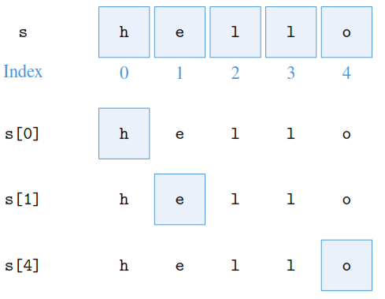
Indexing
hello
s = ‘hello’
>>> s[0]
'h'
>>> s[1]
'e'
>>> s[4]
'o'
01234

Slide 21
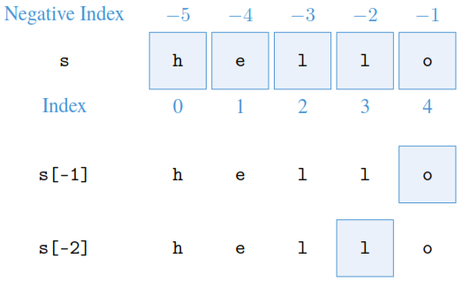
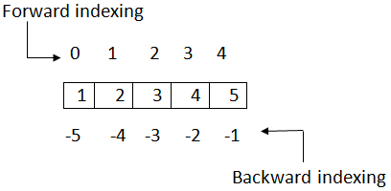
Negative indexing in python
Negative indexes may be used to access the characters from the back (right side) of the string. For example, the last character and second to last can be retrieved using negative indexes 1 and 2, respectively .
>>> s[-1]
'o'
>>> s[-2]
'l'
hello
-5-4-3-2-1

Slide 22
LIST AND TUPLES
In many situations we organize data into a list:
a shopping list,
a list of courses,
a list of contacts on your cell phone,
a list of songs in your audio player, and so on.
In Python, lists are usually stored in a type of object called a list.

Slide 23
STORING DATA IN LIST
A list is a sequence of objects. The objects can be of any type: numbers, strings, even other lists.
For example, here is how we would assign to the variable pets the list of strings representing several pets:
>>> pets = ['goldfish', 'cat', 'dog']
The variable pets evaluates to the list:
>>> pets
['goldfish', 'cat', 'dog']

Slide 24
List representation
In Python, a list is represented as a comma-separated sequence of objects enclosed within square brackets. An empty list is represented as [].
Lists can contain items of diﬀerent types. For example, the list named things in
>>> things = ['one', 2, [3, 4]]
has three items: the ﬁrst is string 'one', the second is integer 2, and the third item is list [3, 4]
things
Location 0
Location 1
Location 2
one
2
[3,4]
string
numeric
list
LIST

Slide 25
List operators
Most of the string operators we have seen in the previous section can be used on lists in similar ways.
For example, the items in the list may be accessed individually using the indexing operator, just as individual characters can be accessed in a string:
>>> pets
['goldfish', 'cat', 'dog‘]
>>> pets[0]
'goldfish'
>>> pets[2]
'dog'
pets
Location 0
Location 1
Location 2
goldfish
cat
dog
string
string
string
LIST

Slide 26
Negative indexing in list
the list pets along with the indexing of the list items. Negative indexes can be used too:
>>> pets[-1]
'dog'
Negative Index
pets
Location -3
Location -2
Location -1
goldfish
cat
dog
string
string
string
LIST

Slide 27
List operations & functions
Explanation | Usage
True if object x is in list lst, false otherwise | x in lst
False if object x is in list lst, true otherwise | x not in lst
Concatenation of lists lstA and lstB | lstA + lstB
Concatenation of n copies of list lst | lst * n, n * lst
Item at index i of list lst | lst[i]
Length of list lst | len(lst)
Smallest item in list lst | min(lst)
Largest item in list lst | max(lst)
Sum of items in list lst | sum(lst)

Slide 28
Executing list operations & Functions
The length of a list (i.e., the number of items in it) is computed using function len():
>>>len(pets)
3
Like strings, lists can be added, meaning that they can be concatenated. They can also be multiplied・by an integer k, which means that k copies of the list are concatenated:
>>> pets + pets
['goldfish', 'cat', 'dog', 'goldfish', 'cat', 'dog']
>>> pets * 2
['goldfish', 'cat', 'dog', 'goldfish', 'cat', 'dog']

Slide 29
Executing list operations & Functions
If you want to check whether string 'rabbit' is in the list, you can use the in operator
in a Boolean expression that evaluates to True if string 'rabbit' appears in list pets:
>>> 'rabbit' in pets
False
>>> 'dog' in pets
True

Slide 30
Executing list operations & Functions
We summarize the usage of some of the string operators. We include in the table functions min(), max(), and sum(), which can take a list as input and return the smallest item, the largest item, or the sum of the items, respectively, in the list:
>>> lst = [23.99, 19.99, 34.50, 120.99]
>>>min(lst)
19.99
>>>max(lst)
120.99
>>>sum(lst)
199.46999999999997

Slide 31
Assignment # 1
To be submitted by solving it on jupyter notebook & email it to me.

Slide 32
Practice problem 2.5
Start by executing the assignment:
s = '0123456789'
Now write expressions using string s and the indexing operator that evaluate to:
(a) '0'
(b) '1'
(c) '6'
(d) '8'
(e) '9'

Slide 33
Practice problem 2.6
words = ['bat', 'ball', 'barn', 'basket', 'badminton']
Now write two Python expressions that evaluate to the ﬁrst and last, respectively, word in
words, in dictionary order.

